Slide 2
Notes:
HANDOUT
Page for facilitators that lists all the hand outs needed for the workshop and the meanings of icons used on the slides in this workshop.
SLIDE NOTES
This module consists of 4 workshops.
WORKSHOP 2
In this workshop participants will:
clarify why identifying and increasing the intellectual challenge of tasks are important
develop some effective strategies and build onto current practice
identify and increase the intellectual challenge of a task by using a particular strategy.

Slide 3
Notes:
MATERIALS
Prepared sets of cards made from Handout 1: Key messages from Workshop 1 (enough for groups of 4-6 to have one set each)
Prizes for activity (optional)
HANDOUTS
Handout 1: Key messages from Workshop 1 (cut this handout up to make a set of 8 cards)
ACTIVITY
This activity asks participants to reflect on the key messages from Workshop 1.
Process:
A set of cards for each group is placed on a desk at the front of the room
One participant from each group comes to the desk and chooses their first card and returns to the group
Together the group work out which key message from Workshop 1 the image represents and writes it down on the card
The answer is brought to the desk by the second person in the group
The answer is checked by the facilitator, if correct the second card is taken, if incorrect the participant returns to the group to try again
The process continues and the first group to explain all cards correctly wins.
A prize may be awarded to the group who wins.
INFORMATION FOR FACILITATORS
The key messages from Workshop 1 are:
The Teaching for Effective Learning (TfEL) Framework guide supports us to create safe conditions for learning.
Emphasise one type of thinking is not being prioritised over another. We need both fluency AND fluency plus thinking.
Analysing the level of thinking a verb requires in a task helps us to identify how intellectually challenging the task is.
Analysing the critical and creative thinking required in a task helps us to identify how intellectually challenging the task is.
ALL students need to engage in both fluency and fluency plus tasks.
Students with growth mindsets are more likely to persist with challenging tasks and see failure as an important part of learning
The ? is for something that was a key personal message.
This activity asks participants to reflect on the key messages and explain them in their own words, rather than remember the exact definitions used in Workshop 1.
When the ? card is selected, the ‘correct answer’ is a personal key message relevant to the participant who selected the card.

Slide 4
Notes:
MATERIALS
Post it notes or photograph of whiteboard generated in the activity from Slide 30, Workshop 1.
SLIDE NOTES
Remind participants of the ideas they generated in Workshop 1 for general rules for increasing the intellectual challenge of tasks.
From ideas such as these, four generalisations have been developed for transforming tasks for increased intellectual challenge.

Slide 5
Notes:
DISCUSSION
When designing strategies for increasing intellectual challenge, tasks tended to be changed ‘from this… to this’.
Ask participants to reflect on the ideas they generated in Workshop 1.
Do you notice any patterns that could be described as moving ‘from this… to this’?

Slide 6
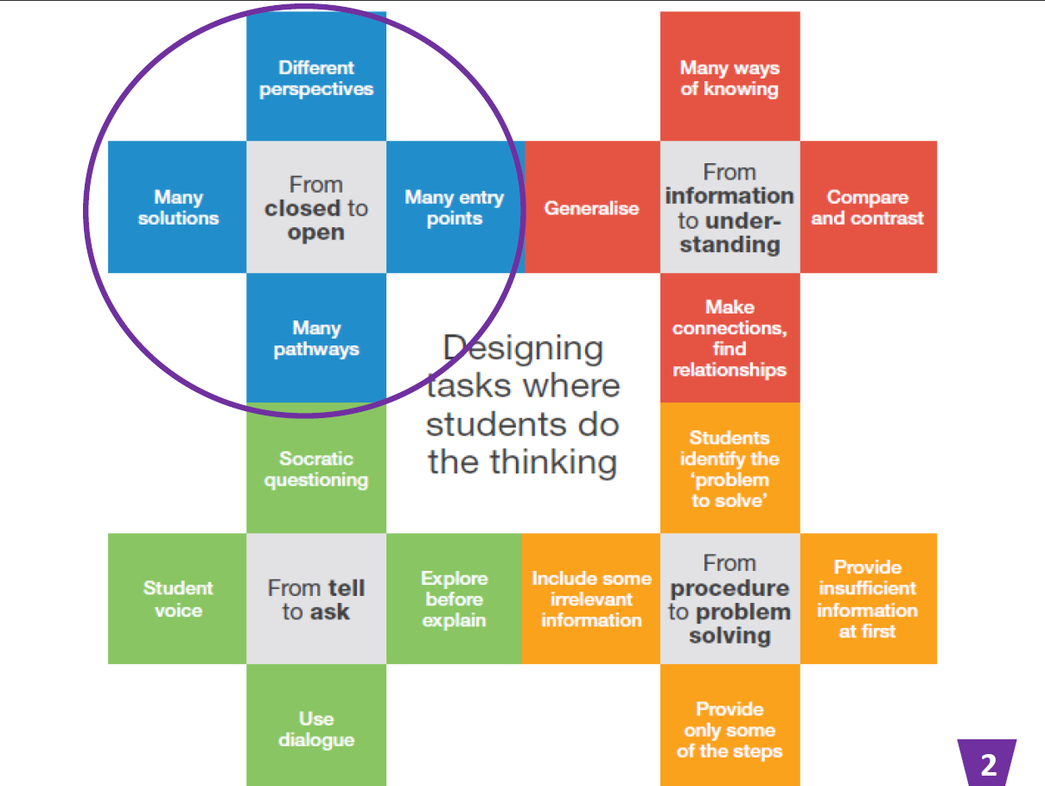
Notes:
HANDOUTS
Handout 2: Transforming tasks strategy diagram
SLIDE NOTES
There are four main strategies:
From closed to open
From information to understanding
From tell to ask
From procedure to problem solving.
For each strategy there are 4 techniques
Explain that it has been intentional to choose 4 strategies and 4 techniques and that they can be applied across all learning areas. Makes it easier to remember ways to change tasks from this to this…
The focus for today’s workshop is looking at the strategy, “From closed to Open’ and the four techniques.

Slide 7
Notes:
SLIDE NOTES
These techniques aren’t the only ways of opening up a closed task but they provide a starting point for thinking about how the intellectual challenge in a task can be increased.
Participants will have already used effective techniques for making closed tasks more open.
DISCUSSION (5 minutes)
Ask participants to give examples in table groups of closed to open strategies they have used in their teaching.

Slide 8
Notes:
ACTIVITY
The purpose of this activity is to engage participants in thinking about the kinds of questions we ask students. Are they closed? Are they open? Or does it depend?
Click through the next ten slides quickly and ask participants to indicate what kind of question they think is shown on the screen:
Closed fist = closed questions
Open hand = open questions
Waving hand = it depends.
INFORMATION FOR FACILITATORS
Remind participants of the key message from Workshop 1. Students need to respond to both open and closed questions.
KEY MESSAGE:
Emphasise one type of thinking is not being prioritised over another. We need both fluency AND fluency plus thinking

Slide 19
Notes:
DISCUSSION
Ask participants to reflect on the questions activity as table groups.
How did you respond to the questions? Why?
When was it hard to choose which hand signal to use?
What did you notice?
SLIDE NOTES
Remind participants of the quote from Workshop 1.
When we are considering the challenge in a question or task, we are focussing on the student thinking that the question or task demands.
The quote by Stein, Smith, Henningsen, Silver highlights the fact that not all tasks have the same level and kinds of intellectual challenge.

Slide 20
Notes:
SLIDE NOTES
An example of how each ‘closed to open’ technique might be used has been provided.
Different perspectives: our thinking can change beyond one point of view, eg how would somebody else respond to this question?
Many solutions: open ended solution but thinking stretched by adding constraints, eg how many ways can you solve the problem that meet this criteria?
Many pathways: there are many possible ways to complete a task, eg how can you solve this problem in more than one way?
Many entry points: thinking does not have to be linear. Have students work backwards by providing the outcome first, eg if this is the answer, what might the question be?

Slide 21
Notes:
HANDOUTS
Handout 3: A3 technique and example signs (one placed in each corner of the room)
SLIDE NOTES
The four ‘closed to open’ techniques and examples have been placed in the four corners of the room.
The next slide will outline an activity where you will have a go at using these techniques and examples.

Slide 22
Notes:
MATERIALS
Prepared envelopes (primary and/or secondary as appropriate) with ‘before’ closed to open tasks cut up from the A3 sheets (handout 4)
HANDOUTS
Handout 4: ‘before’ closed to open tasks
Handout 5: A3 Have a go
Handout 6: Identifying the intellectual challenge of a task
Handout 7: Critical and creative thinking continuum
ACTIVITY
Ask participants to work with a colleague and follow the instructions for the activity on the screen.
PROCESS
With a partner choose a ‘before’ task from the appropriate envelope.
Identify and write the intended learning of the task on the ‘Have a go’ sheet.
Move around the room and explore the 4 different techniques.
Use one or more of the techniques to transform the task with your partner.
Review the intended learning of the task and the thinking your transformed task requires.
INFORMATION FOR FACILITATORS
Remind participants of the handouts introduced in Workshop 1 (Identifying the intellectual challenge of a task and Critical and creative thinking continuum) which can also be used as tools to support them with transforming their tasks.
Remind participants of key messages from Workshop 1.
Question 5, ‘review the intended learning of the task and the thinking your transformed task requires’, asks participants to reflect on how the level and kind of thinking has been changed in their transformed task. It also asks participants to reflect on the intended learning of their transformed task. Has it changed? Has it been added to?
KEY MESSAGES
Analysing the level of thinking a verb requires in a task helps us to identify how intellectually challenging the task is.
Analysing the critical and creative thinking required in a task helps us to identify how intellectually challenging the task is.

Slide 23
Notes:
DISCUSSION
Ask participants to share their transformed tasks with their table groups by reflecting on:
What they did. How they and their partner use one or more ‘closed to open’ techniques to increase the intellectual challenge in the before task.
How they would use the task to
-create safe conditions for learning
-engage all learners
-support learners to persist with challenges?
SLIDE NOTES
Remind participants of key messages from Workshop 1.
KEY MESSAGES
The Teaching for Effective Learning (TfEL) Framework guide supports us to create safe conditions for learning.
ALL students need to engage in both fluency and fluency plus tasks.
Students with growth mindsets are more likely to persist with challenging tasks and see failure as an important part of learning.

Slide 24
Notes:
HANDOUT
Handout 8: Select the Transforming tasks ‘closed to open’ A3 sheets in learning areas/subjects suitable for the participants in this workshop.
DISCUSSION (20 minutes)
Use the following strategy for participants to become familiar with the format.
Think: Participants have 2 minutes to read the sheet and notice how it has been constructed.
Pair: Participants discuss things that they have noticed with a partner.
Share: Participants share their observations with the group.
Ask participants to consider:
How has the type of student thinking been changed in the modified task?
Is there another way you might have transformed the task?
How else could the task be transformed using the techniques suggested?
Could students be challenged to think even deeper?
INFORMATION FOR FACILITATORS
These A3 sheets unpack examples of the ‘closed to open’ strategy using the four different techniques.
These examples are the same ones used in the ‘have a go’ activity from slide 22.
Primary examples are provided on one side and secondary examples on the other.
Column 1:the name of technique being used
Column 2: the ‘before’ task
Column 3: the task after being transformed using the technique by one teacher
Column 4: a summary what the teacher did to change the task, explaining how this would increase student thinking, and how this develops student capacity as independent lifelong learners (powerful/expert learners).

Slide 25
Notes:
MATERIALS
Enough dice for each table group to have one.
ACTIVITY
This activity provides an opportunity for participants to reflect on their learning from Workshop 2.
PROCESS
Each participant at a table group takes it in turns to roll the die.
Participants then have time to reflect on how they might respond to the sentence starter that responds to the number they rolled.
Participants share their reflections with their table group beginning with the selected sentence starter.

Slide 26
Notes:
SLIDE NOTES
Remind participants of the tasks they were asked to bring along as their commitment to action in Workshop 1.
If participants have not bought along a task they can use the one of the before tasks from the A3 sheet and try transforming it using a different closed to open technique.
Remind participants to keep in mind the key messages while they are transforming their task.
INFORMATION FOR FACILITATORS
The key messages:
The Teaching for Effective Learning (TfEL) Framework guide supports us to create safe conditions for learning.
Emphasise one type of thinking is not being prioritised over another. We need both fluency AND fluency plus thinking.
Analysing the level of thinking a verb requires in a task helps us to identify how intellectually challenging the task is.
Analysing the critical and creative thinking required in a task helps us to identify how intellectually challenging the task is.
ALL students need to engage in both fluency and fluency plus tasks.
Students with growth mindsets are more likely to persist with challenging tasks and see failure as an important part of learning.

Slide 27
Notes:
SLIDE NOTES
These workshops have been designed so that participants have the opportunity to apply information in their own context.
The commitment to action for this session is to use their transformed task with their students and reflect on what they noticed and how students responded to the task ready for Workshop 3.

