Slide 2
Notes:
HANDOUTS
Page for facilitators that lists all the hand outs needed for the workshop and the meanings of icons used on the slides in this workshop.
SLIDE NOTES
This is the third workshop in the transforming tasks module.
WORKSHOP 3
In this workshop participants will:
Further develop effective strategies and build onto current practice
Share their commitment to action from Workshop 2
Identify and increase the intellectual challenge of a task by using the ‘Tell to ask’ strategy.

Slide 3
Notes:
SLIDE NOTES
Ask participants to continue to keep in mind the key messages of the last workshops:
The Teaching for Effective Learning (TfEL) Framework guide supports us to create safe conditions for learning.
Emphasise one type of thinking is not being prioritised over another. We need both fluency AND fluency plus thinking.
Analysing the level of thinking a verb requires in a task helps us to identify how intellectually challenging the task is.
Analysing the critical and creative thinking required in a task helps us to identify how intellectually challenging the task is.
ALL students need to engage in both fluency and fluency plus tasks.
Students with growth mindsets are more likely to persist with challenging tasks and see failure as an important part of learning
The ? is for something that was a key personal message.
The focus of this workshop is to design tasks where ALL students are engaged in tasks requiring different kinds and levels of thinking.
Let’s begin by looking at the intellectual challenge within some tasks.

Slide 4
Notes:
MATERIALS
Prepared set of cards made from Handout 1: ‘Sort from least to most intellectual challenge’ cards.
Enough for one set per pair.
HANDOUTS
Handout 1: ‘Sort from least to most intellectual challenge’ cards (cut this handout up to make a set of 7 sorting cards).
Please note: Handout 1 contains 2 identical sets of sorting cards.
ACTIVITY
This activity asks participants to work in pairs to sort the tasks from least to most intellectually challenging.
Process:
Participants work in pairs to sort the tasks from least to most intellectually challenging
Each pair shares their order with the other pairs at their table giving reasons for their selections
Ask groups to determine whether it is possible for there to be one correct order in which to sort the cards.
SLIDE NOTES
The participants will probably say it is not possible for there to be one correct order to sort the cards because ‘it depends’ on things such as:
The context
Perspective and personal relevance
The thinking required to do the task eg. recall, remember, analyse, infer etc.
Recall: you either know what a surd is or you don’t
Remember: you either remember the story of Red Riding Hood or you don’t
Analyse: to work out the rate of acceleration you would need to analyse the gradient of the slope, the size and weight of the marble, the force moving the marble etc.
Infer: to create a recipe for a special dish you need to infer who the dish is for, the occasion it will be served, where it will be served etc.
Whether students can easily access the information required.
INFORMATION FOR FACILITATORS
Important to highlight: intellectual challenge is not about how hard the work or the content is.
For example, giving Year 1 students Year 2 content or giving a Year 10 students more practice using a skill they have already mastered is not what we mean by intellectual challenge.
Intellectual challenge refers to the types and levels of thinking that are required of the students as they engage in the learning.

Slide 5
Notes:
HANDOUTS
Handout 2: Transforming tasks strategy diagram
SLIDE NOTES
We looked at the ‘From closed to open’ strategy in Workshop 2, and we will revisit your commitment to action using this strategy later in this workshop.
The four main strategies to develop tasks that get students doing the thinking were introduced in the last workshop. These are:
From closed to open
From tell to ask
From procedure to problem solving
From information to understanding.

Slide 6
Notes:
HANDOUTS
Handout 3: Tell to ask techniques and examples
SLIDE NOTES
In this workshop we will be focussing on the ‘From tell to ask’ strategy and its 4 techniques:
Explore before explain
Socratic questioning
Student voice
Use dialogue.
The underlying principle behind this strategy is to ask students what they think before looking at what other people think.
This is an effective strategy for both student engagement and deep understanding of concepts.
An example of how each ‘From tell to ask’ technique might be used has been provided.
Explore before explain: ask students to try their ideas first
Socratic questioning: ask questions that help students dig deeper
Student voice: ask students to decide how they might do this best
Use dialogue: ask students to interact and build meaning through learning conversations.

Slide 7
Notes:
SLIDE NOTES
Remember that one approach is not being prioritised over another, but about using and developing a range of approaches to enhance student thinking. Sometimes it is more appropriate to tell.
KEY MESSAGE:
Emphasise one type of thinking is not being prioritised over another. We need both fluency AND fluency plus thinking.

Slide 8
8
Notes:
SLIDE NOTES
Participants will have already used effective techniques for allowing students to explore before being given an explanation.
DISCUSSION (2 minutes)
Ask participants to give examples in table groups of how they have used ‘Explore before explain’ in their teaching.
Ask different groups for examples of their ideas.

Slide 9
9
Notes:
SLIDE NOTES
Some ideas that have been suggested in the past include:
5Es teaching and learning model
KWHL (Think I know, Want to know, How I’ll find out, What I learned).
Human graph
Concept /mind map
Graphic organisers, eg fishbone or spider diagram
Prediction
Sorting and generating ideas
Hands-on exploratory activities.
DISCUSSION
Ask participants to discuss/tease out any other ideas that these examples make them think of. (2 minutes)

Slide 10
Notes:
HANDOUTS
Handout 4: Critical and creative thinking continuum
SLIDE NOTES
Ask participants to think about the examples they discussed about how they have used an ‘Explore before explain’ technique in relation to the Critical and creative thinking continuum.
Where does the example fit on the continuum?
What might you do that would move this example further along the continuum?
KEY MESSAGE
Analysing the critical and creative thinking required in a task helps us to identify how intellectually challenging the task is.

Slide 11
11
Notes:
SLIDE NOTES
The example given for the ‘Explore before explain’ technique is for students to try their ideas first.
Asking questions of students as they explore and try out their ideas, increases intellectual challenge, as illustrated in this quote.
Reinhart is a researcher and teacher of mathematics, who discovered his students’ problem solving abilities blossomed when he began talking less and questioning more.
His advice was, “Ask the best possible questions… and apply strategies that require all students to participate.” (Reinhart, 2000, p. 479).
REFERENCE
S Reinhart: “Never say anything a kid can say. Mathematics Teaching in the Middle School”, 2000

Slide 12
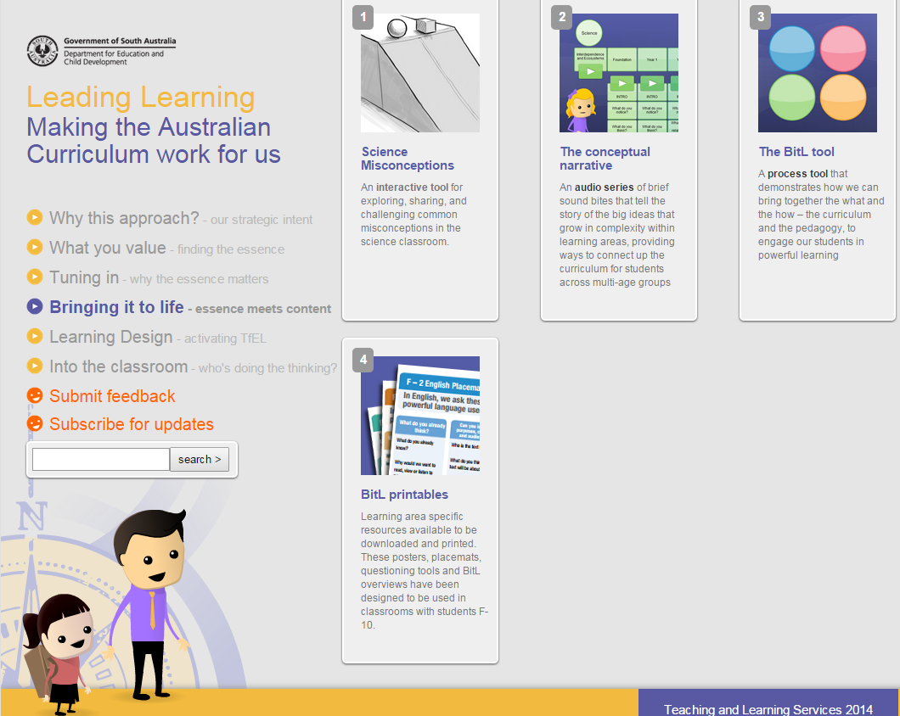
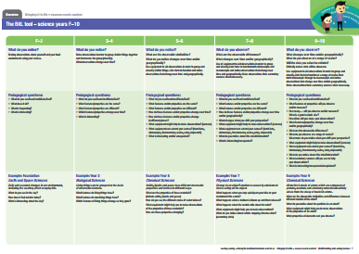
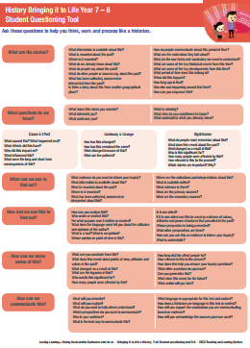
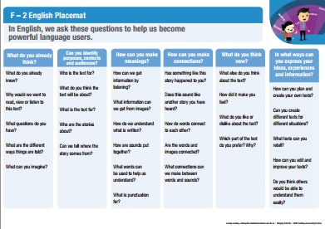
Bringing it to Life(BitL) tools
Try using the BitL tool to differentiate learning.
www.acleadersresource.sa.edu.au
12
Notes:
SLIDE NOTES
A useful starting point for devising questions that challenge student thinking as they engage in exploratory activities are the Bringing it to Life (BitL) tools. These are online resources on the Leading Learning website.
www.acleadersresource.sa.edu.au
The BitL tools may be a useful reference when designing learning.
They suggest questions such as ‘What do you notice?’ ‘What does that make you think?’ ‘What questions do you have?’, and gives examples of how these questions can be used across learning areas.
These questions can be used to differentiate learning so that all students are engaged, challenged and supported.
For example, Year 6 history topic: Federation and decision making in Australia. The teacher used questions from the History BitL tool to engage in thinking about how and why decisions are made in Australia. For one student with additional learning needs, the teacher selected questions from the F-2 BitL tool so that the student could access the same intended learning as the rest of the class.
These questions allowed the student to personalise and connect with the learning and make sense of how and why decisions are made in Australia.
Year 5/6 BitL question: What is recorded about decision making in Australia’s past? (documents on museum websites showing how Australia became a Federation)
Foundation-Year 2 BitL question: What do people you know say about how decisions are made in Australia? (personal experiences of going to the polling booth on Election Day with parents)
ACTIVITY (optional)
Process:
Click the link on the slide to view the Bringing it to Life section of the Leading Learning website
Show participants where to find BiTL printables
Distribute printed copies of Bringing it to Life tools from the ‘BitL printables’ in relevant learning areas and year levels
Ask participants to work in pairs and familiarise themselves with the questions
Ask participants to consider the kind and levels of thinking required by these questions
Discuss how these questions could be used when students are engaged in exploratory activities.
HANDOUT (optional) printed copies of Bringing it to Life tools from the ‘BitL printables’ in relevant learning areas and year levels (at least one per pair).
KEY MESSAGE
ALL students need to engage in both fluency and fluency plus tasks.

Slide 13
13
Notes:
SLIDE NOTES
This is the commitment to action from Workshop 2.
You will be using the ‘Tell to ask’ technique of ‘Socratic questioning’ to discuss the ‘Closed to open’ transformed task you tried with your students.

Slide 14
14
Notes:
SLIDE NOTES
We will be digging a little deeper with our questioning technique for this activity, using Socratic types of questioning to discuss our work.
Socratic questions gives individuals the opportunity to construct their own meaning through rigorous analysis of ideas because they:
Are systematic and disciplined
Probe below the surface
Assess truth or plausibility.
Students who know how to use Socratic questioning, learn to deeply analyse, critique and assess the thinking of themselves and others, including text analysis.
INFORMATION FOR FACILITATORS
Socrates was a Greek Philosopher who is believed to have lived 400 years BCE.
Socratic questions are systematic questions that deeply probe thinking. They model an inquiring, probing way of thinking by continually probing into the subject with questions and help develop deep understanding and awareness, but can also bring to light contradictions and flaws in thinking. This also means that they can cause some discomfort as ideas are reassessed.
Establishing an environment where people feel safe to explore their thinking is crucial.

Slide 15
Notes:
SLIDE NOTES
Socratic questions are used to probe deeper than just seeking one right answer, and the questioner responds to whatever answer is given with another question.
For example, if asked ‘Which object is heavier – the apple or the lemon?’
The questioner might respond to the answer given with questions such as:
What are your reasons for thinking that?
Is that always true?
What would cause you to change your mind?
In this instance, such questioning could lead to the analysis of what we mean by heaviness … Do we define heaviness as density or the comparative weight of two objects?
Right answers are less important than stimulating thinking and curiosity.
INFORMATION FOR FACILITATORS
You may choose to model this process with a participant from the group.
After the process, ask the question ‘What did you notice?’
Participants may have noticed that you only responded to the volunteer with further questions.

Slide 16
16
Notes:
HANDOUTS
Handout 4: Teaching for Effective Learning Framework – Three big ideas
SLIDE NOTES
Because of the probing nature of the questioning, it is important that students feel safe to be challenged and don’t see the questioning as being judgemental or threatening.
Domain 2 of Teaching for Effective Learning Framework emphasises the need to create safe conditions in order to facilitate rigorous thinking and learning.
DISCUSSION
Distribute Handout 4 and ask participants to reflect on the questions in Domain 2 and think about whether this is true for all students in their class/es.
INFORMATION FOR FACILITATORS
If we want our tasks to work harder for us, so that students are doing the thinking, we need to think about how we create the conditions for learning in the classroom.
The Teaching for Effective Learning (TfEL) Framework guide supports us to create these conditions in three domains:
Create safe conditions for rigorous learning
Develop expert learners
Personalise and connect learning.
We think about these domains as being the three big ideas of TfEL:
Safety for challenge in learning
Knowing what to learn… knowing how to learn it
Connecting learning to students’ lives and contexts.
Domain 2 in particular focuses on establishing a low threat environment where students feel safe to be challenged in their learning.
KEY MESSAGE
The Teaching for Effective Learning (TfEL) Framework guide supports us to create safe conditions for learning.

Slide 17
Notes:
SLIDE NOTES
Collaboratively developing group protocols with students can be an effective way of creating a safe environment for challenge.
Some examples of protocols that could be considered are:
Focus on the task and the thinking
Non judgemental
Questions are asked with a positive intent (no ulterior agenda)
The option to come back to me
Share in multiple ways
DISCUSSION
Ask participants in their groups to discuss and agree on, the protocols they would like to put in place whilst discussing their commitment to action from Workshop 2.
KEY MESSAGE
The Teaching for Effective Learning (TfEL) Framework guide supports us to create safe conditions for learning.

Slide 18
Notes:
HANDOUTS
Handout 5: Transforming Tasks ‘Socratic questioning’ cards (cut this handout up to make a set of 9 cards for each group of 3).
ACTIVITY
Participants use Socratic questioning to discuss the ‘Closed to open’ transformed task they tried with their students.
Process:
Ask participants to form groups of 3
A set of Socratic questioning cards is placed face-up so that everyone in the group can see them
Groups assign roles as follows:
Interviewee: describes the task they transformed using a ‘Closed to open’ technique and how it went when they tried it with their students (2 minutes)
Questioner: chooses questions from the Socratic questioning cards to guide the line of questioning (2 minutes). The questioner asks questions only, they do not comment, give opinions or respond in any way other than to ask further questions. The questioner may also construct their own questions to suit the context.
Timer: ensures each person has equal time in the different roles and monitors the 2 minute time slots. The timer does not contribute to the conversation.
4. Participants rotate roles so that each has a turn at discussing their work/time keeping/questioning.

Slide 19
Notes:
SLIDE NOTES
Models such as these can be helpful in determining the intent of the Socratic questions you want to ask.
INFORMATION FOR FACILITATORS
These tables illustrate models that help us develop Socratic types of questions. They have been developed by Dr Richard Paul, author of The Art of Socratic Questioning (2006) and Michael Pohl.
REFERENCES
Dr. Richard Paul and Dr. Linda Elder: “The Thinker’s Guide to The Art of Socratic Questioning”, 2006, The Foundation for Critical Thinking
Michael Pohl: “Teaching Complex Thinking: Critical. Creative. Caring”, 2000, Hawker Brownlow Education

Slide 20
Notes:
HANDOUTS
Handout 6: Plus, minus, interesting
SLIDE NOTES
Give participants a couple of minutes to reflect on the Socratic questioning process –the pluses, the minuses and the interesting. How did they feel? What would they do next time?
DISCUSSION
Ask participants how they might use the Socratic questioning process with their students.
Would all students be able to engage in this process? How might they be supported?
Participants may reflect on times when students have been reluctant to answer questions, or responded with ‘I don’t know’. Ask participants what they might do and to share examples of successful experiences with helping students to join a dialogue.
Examples of how you might respond in these instances:
‘What do you think someone who did know might say?’
‘If you did know the answer what might it be?’
‘What would the answer definitely not be?’
KEY MESSAGES
ALL students need to engage in both fluency and fluency plus tasks.
Analysing the critical and creative thinking required in a task helps us to identify how intellectually challenging the task is.

Slide 21
Halifax Children’s Centre
Mt Barker High School
https://vimeo.com/87437307
21
Notes:
VIDEO
https://vimeo.com/87437307
Halifax Kindergarten 0:00 -3:58 mins
Mt Barker High School 3:58 – 8:15
SLIDE NOTES
The next technique in the ‘Tell to ask’ strategy is ‘Student voice’.
These videos provide a starting point for this technique.
Show an excerpt from the video as a provocation for discussion about student voice. Choose the section of the video that best relates to the audience.

Slide 22
Notes:
DISCUSSION
Ask participants to reflect on the video they watched and think about how student voice was activated using the prompts on the slide as a guide.

Slide 23
Notes:
ACTIVITY
Ask participants to reflect on the questions (in the purple boxes) about their own experience of activating student voice in learning.
SLIDE NOTES
The example given for the Student voice technique is to ‘Ask students how they might do this best’.
At any point in a task, students are asked to decide :
How they might find out information, evidence, examples etc.
Which mode of learning is most suitable for the task
How they might best demonstrate their learning
How their learning will be assessed.
Process:
Participants personally reflect on the questions
Share reflections in table groups.

Slide 24
24
Notes:
HANDOUTS
Handout 7: Comfort zone
Please note: Handout 7 contains 2 identical ‘Comfort zone’ tables.
ACTIVITY
Ask participants to rank the modes on Handout 7 from 1 to 5 according to how comfortable they would feel using them to share their examples of student voice with the whole group.
Process:
Provide each participant with Handout 7
Explain that participants are going to share at least one of their examples with someone they haven’t worked with during this workshop
Ask them to rank from 1-5, how comfortable they would feel using the different modes on the handout to share their example
Ask participants to pair up with someone from another table group
Explain to participants that they will be sharing their example using the mode that they ranked third
Give participants time to prepare their example using the mode they ranked third (2 minutes)
Each person in the pair shares their example using the mode they ranked third (2 minutes for each participant)
Ask participants to return to table groups
Ask participants, “Why do you think you were asked to use the mode you ranked third and not one of your more comfortable modes?”
INFORMATION FOR FACILITATORS
Challenging students to move beyond their comfort zones is an important aspect of supporting them to achieve high standards with appropriate support (TfEL 2.4)
‘Good learning happens best in the stretch zone, not in a panic, or when too comfortable.’
Students are the best judges of their own comfort zones and teachers need to continually nudge them to challenge their expectations of themselves.
For example, in the Comfort zone activity you were nudged to moved beyond your preferred mode of sharing.
KEY MESSAGE
The Teaching for Effective Learning (TfEL) Framework guide supports us to create safe conditions for learning.

Slide 25
Notes:
HANDOUTS
Handout 8: select the Transforming tasks ‘From tell to ask’ A3 sheets in learning areas/subjects suitable for the participants in this workshop.
SLIDE NOTES
Another technique of the ‘From tell to ask’ strategy is ‘Use dialogue’.
We are now going to use this technique to analyse the ‘Tell to ask’ A3 sheets.
Distribute Handout 8 and give participants 5 minutes to read it.

Slide 26
Notes:
SLIDE NOTES
The example given of the ‘Use dialogue technique is to ‘Ask students to interact and build meaning through learning conversations.’
One example of this is to use a Community of Inquiry as a democratic structured dialogue where students build meaning through their conversations. This process could incorporate Socratic types of questions.
We are going to be using a Community of Inquiry process in the next activity, where we analyse the ‘From tell to ask’ A3 sheets.
REFERENCE
Conducting a Community of Inquiry
http://museumvictoria.com.au/education/community-of-inquiry/
KEY MESSAGE
The Teaching for Effective Learning (TfEL) Framework guide supports us to create safe conditions for learning.

Slide 27
Notes:
MATERIALS
Enough ‘stones’ for each participant to have 5 (eg. counters, blocks, coins, shapes etc.)
A ‘stick’ for each table group (eg. ruler or pop stick).
ACTIVITY
Participants use the Community of Inquiry to analyse the ‘From tell to ask’ A3 sheets.
Process:
Participants work in table groups
Give each participant 5 ‘stones’ and place one ‘speaking stick’ on each table
Follow the Community of Inquiry protocols to structure a group dialogue using the guiding questions on the next slide about the ‘From tell to ask’ A3 sheets.
INFORMATION FOR FACILITATORS
Because it is a democratic discussion, there are protocols to ensure everyone has the opportunity to participate uninterrupted.
The procedural protocols on the slide assist the process to run smoothly.
The protocols for a safe learning environment that they developed earlier would be a useful reference.
The questions are on the next slide.

Slide 28
Notes:
ACTIVITY
Participants use the Community of Inquiry to analyse the ‘From tell to ask’ A3 sheets.
Process:
Participants work in table groups
Give each participant 5 ‘stones’ and place one ‘speaking stick’ on each table
Follow the Community of Inquiry protocols to structure a group dialogue using the guiding questions about the examples on the ‘From tell to ask’ A3 sheets.

Slide 29
Notes:
SLIDE NOTES
Ask participants to reflect on the ‘From tell to ask’ strategy and its 4 techniques with the key messages.
Explore before explain
Socratic questioning
Student voice
Use dialogue.
INFORMATION FOR FACILITATORS
This reflection is in preparation for deciding on which technique participants would like to try as their commitment to action before the next workshop.

Slide 30
30
Notes:
SLIDE NOTES
These workshops have been designed so that participants have the opportunity to apply information in their own context.
The commitment to action for this session is to transform a task and use it with their students and reflect on what they noticed and how students responded to the task ready for Workshop 4.
Ask participants to think about the Critical and creative thinking continuum as they transform their task. Where does it fit? What can they do to move it along (if needed)?

