Slide 1
Notes:
SLIDE NOTES
This is the fourth workshop in the Transforming Tasks Module.

Slide 2
DEPARTMENT FOR EDUCATION AND CHILD DEVELOPMENT
OFFICE FOR EDUCATION
2
Notes:
SLIDE NOTES
This is the fourth workshop in the Transforming Tasks Module (Workshop 4).
In this workshop participants will continue to develop some effective strategies and build onto current practice.
Facilitators should allow approximately 3 hours to deliver the full workshop, over one or more sessions.
INFORMATION FOR FACILITATORS
The Transforming Tasks strategies and techniques allow all learners, including Aboriginal learners, to enter the learning at their own level, using different learning styles in a culturally safe environment.
The notes in this workshop highlight some examples of these strategies that are supported by research.

Slide 3
Notes:
HANDOUTS
Handout 1: Procedure to problem solving, strategy and example techniques.
SLIDE NOTES
The four strategies of Transforming Tasks are:
From closed to open
From tell to ask
From procedure to problem solving
From information to understanding.
The focus of this workshop is the ‘From procedure to problem solving’ strategy.

Slide 4
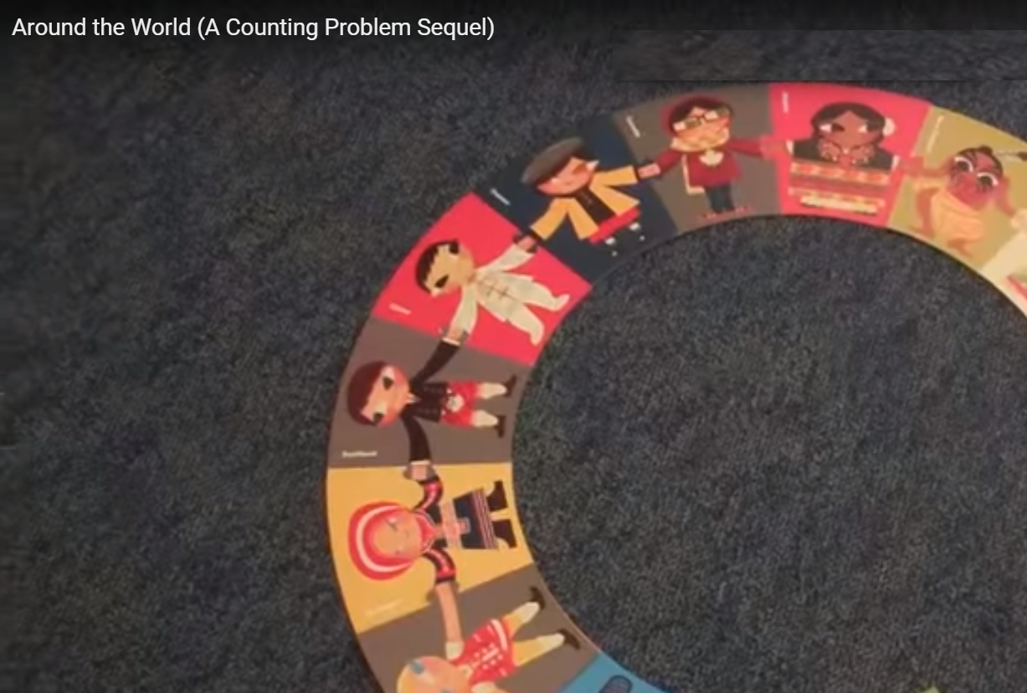
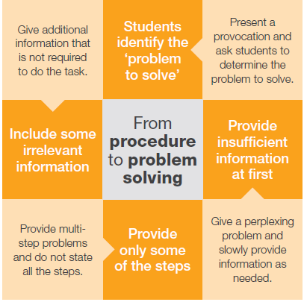
Secondary
Around the World
https://www.youtube.com/watch?v=vPnSQD5ca7M
Primary
How to Arrange a Train
https://www.youtube.com/watch?v=SrWt_XvWLUk
Notes:
SLIDE NOTES
The videos are provocations for initial discussion.
Ask participants to watch one of the videos, and to try to determine which of the procedure to problem solving techniques they think the teacher (UK teacher Justin Solonynka) could be using in the delivery of the lesson.
VIDEO
Choose the video that best suits the audience.
https://www.youtube.com/watch?v=SrWt_XvWLUk
Primary – How to Arrange a Train 3:38 mins
https://www.youtube.com/watch?v=vPnSQD5ca7M
Secondary – Around the World 4:06 mins
DISCUSSION (2 minutes)
Ask participants to discuss their observations and thinking in a table group.
Refer participants to Handout 1 – ‘From Procedure to problem solving’ strategy
Ask participants:
Where did they think the strategies used in the lesson connect with the ‘From Procedure to problem solving’ strategy?
SLIDE NOTES
Collect participant ideas, and suggest that the teacher probably ‘determined the problem to solve’, but ‘released information slowly’ and ‘did not state the steps’.
The teacher didn’t ‘give information that was irrelevant to the task’.
Explain that in a lesson or unit of work, one or more of the techniques from the – ‘From Procedure to problem solving’ strategy could be used. It could be, but doesn’t have to be, a lesson sequence.

Slide 5
Notes:
SLIDE NOTES
Remind participants of the Socratic questioning technique from the ‘From tell to ask’ workshop.
Socratic questions are useful to help us to think analytically and deeply.
They can be questions that probe consequences, assumptions, reasons, perspectives and so on.
INFORMATION FOR FACILITATORS
This chart shows 8 perspectives that can be used to help us develop Socratic types of questions. They have been developed by Dr Richard Paul and Dr. Linda Elder, author of The Art of Socratic Questioning (2006)
REFERENCES
Dr Richard Paul and Dr Linda Elder: “The Thinker’s Guide to The Art of Socratic Questioning”, 2006, The Foundation for Critical Thinking.
Michael Pohl: “Teaching Complex Thinking: Critical. Creative. Caring”, 2000, Hawker Brownlow Education.

Slide 6
Notes:
ACTIVITY
Ask participants to generate as many ‘Socratic type’ questions as they can about the video that they have just seen.
For example, they could ask about the consequences of a teacher action, or speculate why a particular question was used as a prompt, or to consider alternative viewpoints.
Give participants a 2 minute time limit.
Acknowledge the group that generates the most questions.
SLIDE NOTES
Ask participants to analyse the purpose of the activity.
Emphasise the following intentions:
To recognise that there are consequences and underlying motives in the way we deliver our lessons
To emphasise that we should plan not just our content intentionally, but also our pedagogy.

Slide 7
Notes:
HANDOUTS
Handout 2: Plus, Minus, Interesting
ACTIVITY
Ask participants to use their questions as a basis for a small group discussion about the video, filling in a group PMI (Plus, Minus, Interesting) chart to record their thoughts.
INFORMATION FOR FACILITATORS
The teacher was an active participant in the lesson - he didn’t ‘abandon’ the students with the problem, but used guiding questions to support their thinking.
He had a clear understanding and knowledge of the mathematical concepts required.
Students were encouraged to discuss and share ideas.
In considering your Aboriginal learners, research has shown that Aboriginal learners are more likely to take risks in learning new content if they are able to work collaboratively to explore it. This enables them to bring their own cultural perspective on new knowledge as they try to make sense of what it means for them. (Yunkaporta, 2009) (Harris, 1980)
REFERENCES
Yunkaporta, T., Aboriginal pedagogies in the cultural interface (2009)
Harris, S., Culture and learning: Tradition and education in Northeast Arnhem Land, Darwin (1980)

Slide 8
4
5
8
Notes:
HANDOUTS
Handout 3: Teaching for Effective Learning Framework (TfEL) – Domain 2
SLIDE NOTES
Domain 2 of TfEL emphasises the need to create safe conditions in the classroom environment, in order to facilitate rigorous thinking and learning.
DISCUSSION
Ask participants to discuss which elements from Domain 2 they think were evident in the lesson.
INFORMATION FOR FACILITATORS
If we want our tasks to work harder for us, so that students are doing the thinking, we need to think about how we create the conditions for learning in the classroom.
The TfEL Framework guide supports us to create these conditions in three domains:
Create safe conditions for rigorous learning – (The big idea is ‘Safety for challenge in learning’)
Develop expert learners (Big idea is ‘Knowing what to learn… knowing how to learn it’)
Personalise and connect learning – (Big idea is ‘Connecting learning to students’ lives and contexts’)
KEY MESSAGE
The TfEL Framework guide supports us to create safe conditions for learning.

Slide 9
9
Notes:
DISCUSSION
Ask participants to reflect on the questions from Domain 2.
Were these true for all students in the class?
What strategies were used to create safe conditions for learning, without compromising the challenge of the task?
How was the task able to both stretch and support the diversity of learners, including challenging and/or scaffolding Aboriginal or EALD learners?
KEY MESSAGE
The Teaching for Effective Learning (TfEL) Framework guide offers support and guidance in how to create safe conditions for rigorous learning.

Slide 10
Notes:
SLIDE NOTES
These workshops have emphasised the connection between the strategies and techniques of Transforming Tasks for Intellectual Challenge and the elements of TfEL.
They are both built on the same global research of effective teaching and learning, and work together to support the pedagogical shift: ‘From this, to this’, that is required for effective learning.
The connection between Domain 2 ‘Create safe conditions for rigorous learning’, for example, has already been discussed.

Slide 11
Notes:
SLIDE NOTES
Remind participants, that adding the techniques and strategies of ‘ From procedure to problem solving’ to their pedagogical tool kit, does not mean that teaching using procedures is obsolete. Effective teachers have a range of strategies, and know when to best use them.

Slide 12
12
Notes:
SLIDE NOTES
These workshops have been designed so that participants have the opportunity to apply information in their own context.
The commitment to action from Workshop 3 session was to transform a task using the ‘Tell to ask’ strategy, and to use it with their students, reflecting on student response and other observations and questions.

Slide 13
Notes:
DISCUSSION
Participants will be working in groups of no more than 3, taking turns to summarise their experiences in applying the ‘From tell to ask’ strategy in their context.
Be strict on time limit. Ask participants to set their timer to give 3 minutes for each person to share. (Suggest 1 minute to address each of the questions).
Their 3 minute response will reflect on the following questions:
Which technique did you try?
Describe what you did. Explain how that was different from previous practice.
What happened? How did the students respond?
What did you learn? What might you change next time?

Slide 14
Notes:
HANDOUT
Handout 4: Critical and creative thinking continuum
SLIDE NOTES
Remind participants of the Critical and Creative Thinking continuum from previous workshops, and how it provides guidance to the kinds and levels of thinking that might be appropriate at different year levels.
ACTIVITY
Ask them to:
self assess their activity by ‘doing a temperature check’ of the kind of thinking their lesson provoked, and the level of thinking at which it was pitched.
DISCUSSION
Consider the potential for using the continuum to differentiate the task. How might their different learners have been catered for within the task?

Slide 15
Notes:
SLIDE NOTES
Let’s be clear. These strategies, could be nothing more than ‘tricks’ – unless delivered as intentional pedagogy to develop the thinking capabilities of learners.
However, they have the potential to connect the pedagogy of Teaching for Effective Learning with elements of the General Capabilities. (Note logo change for General Capabilities v.8)
When we are intentional in our pedagogy it changes a ‘trick’ into a key pedagogic strategy that can enable targeted types of thinking and learning.
KEY MESSAGE
The Teaching for Effective Learning (TfEL) Framework, General Capabilities Continuum and the Transforming Tasks strategies work in synergy towards the pedagogic shift required for 21st Century education.

Slide 16
Notes:
SLIDE NOTES
Ask whether participants have heard of an American maths educator named Dan Meyer. His 2010 TED talk ‘Math class needs a makeover’ brought him global attention.
His maths strategy is structured a bit like a performance, and called ‘Three Act Maths’.
Participants may have seen Professor Martin Westwell playing an excerpt of Dan Meyer’s talk using a ski lift problem. The DECD Maths Conceptual narratives on the Leading Learning resource have direct links to Dan Meyer videos.
The features of Three Act Maths are :
Act 1: Introduces the context.
Act 2: Main body (like the main body of the lesson).
Act 3: Resolution to the problem, reflection, “setting up the sequel” (to quote Dan Meyer).
RESOURCES
Dan Meyer TED talk: Math class needs a makeover
https://www.ted.com/talks/dan_meyer_math_curriculum_makeover?language=en

Slide 17
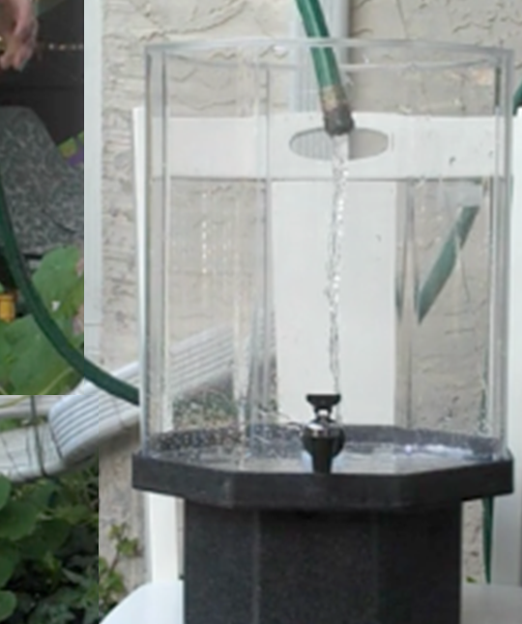
Act 1
Act 1
Introduction
What questions come to mind?
http://threeacts.mrmeyer.com/watertank/act1/act1.mov
Notes:
VIDEO
http://threeacts.mrmeyer.com/watertank/act1/act1.mov
SLIDE NOTES
This video is an excerpt from one of Dan Meyer’s maths provocations.
Play the video, but say nothing for a few seconds, in order to give participants felt meaning of the learning experience.
In his maths class, Dan plays the video of an aquarium being slowly filled with water, and says nothing. Soon the students are asking - ‘How long is this going to take?’, and he starts to collect questions and predictions about how long they think it will take.
DISCUSSION
Brainstorm some participant ideas about:
How long do participants think it will take to fill?
What length of time are they certain would be too short/too long?
What is the time range that they feel reasonably confident about?
What do you need to know to be able to work it out?

Slide 18
Notes:
HANDOUT
Handout 5: Teacher actions: sorting tasks
MATERIALS
Prepared envelopes with the teacher actions cut up.
ACTIVITY
Participants place the ‘teacher actions’ in the order they think Dan would have delivered his lesson. (3 minutes)
Process:
Provide each group of 2-3 participants with an envelope containing the six ‘teacher actions’ cards.
Ask them to sort the actions in the order they think Dan would have used in delivering his lesson, and discuss the possible impact of the different teacher actions on student thinking.

Slide 19
Notes:
SLIDE NOTES
Give participants a moment to compare their ideas about teacher actions to those on the slide.
Does the order of delivery matter? Why? What do participants think?
Explain how sorting the generated questions, into 2 groups – (questions that require mathematical thinking, and those that don’t), means student participation during the question generation activity is not discouraged, because questions that are not mathematical get the same response as those which are mathematical.
Furthermore, asking students to identify the maths questions develops student understanding of the scope of mathematics.
The teacher is able to focus on the desired learning by highlighting the question which will develop the intended maths concept (teacher action 5).
Dr Thelma Perso would say that using a pedagogical sequence like this supports both engagement in a task and developing the language and literacy demands in a safe environment.
REFERENCE
Perso, T. 2013
Numeracy: What classroom teachers should know. Australian Association of Mathematics Teachers AAMT

Slide 20
Notes:
SLIDE NOTES
Refer participants to Handout 1 – ‘From Procedure to problem solving’ strategy.
DISCUSSION
Ask participants to briefly discuss:
Where does this introduction activity connect with the ‘From Procedure to problem solving’ strategy?
What do they think Dan’s intentions were in Act 1?

Slide 21
Notes:
SLIDE NOTES
The purpose of Act 1 is getting ‘students to identify the problem to solve’.
A provocation can hook students in to asking questions, noticing and wondering, and takes them from being passive recipients to being active learners.
This is quite different from presenting a preconceived problem in a text book.
Presenting problems in this way:
increases student intrigue or intellectual engagement
develops student capacity as authentic critical questioners.

Slide 22
Students determine the problem
www.ted.com/talks/dan_meyer_math_curriculum_makeover?language=en
Notes:
SLIDE NOTES
In this video excerpt Dan Meyer discusses the text book version of the problem and emphasises that the formulation of the problem is the most important, and that students need opportunities to formulate the problem.
VIDEO
Use a 3 min extract from Dan Meyer’s TED talk (from 6:31 min to 9:41 min - ‘We’ve redefined what a maths problem is’.)
www.ted.com/talks/dan_meyer_math_curriculum_makeover?language=en

Slide 23
Where can I find more ideas?
blog.mrmeyer.com/2011/the-three-acts-of-a-mathematical-story/
Notes:
SLIDE NOTES
More ideas for provocations can be found on the Dan Meyer website.
http://blog.mrmeyer.com/2011/the-three-acts-of-a-mathematical-story/

Slide 24
Notes:
SLIDE NOTES
Activities should be selected intentionally, targeting the development of specific understanding, dispositions and skills.
The Learning Design thinking tool on the Leading Learning resource is a useful tool to help teachers to be intentional and strategic when designing learning experiences.
The justice alerts in the Teaching for Effective Learning framework can provide useful ideas when thinking about the predispositions that your diverse learners bring.
REFERENCE
Learning Design
http://www.acleadersresource.sa.edu.au/index.php?page=learning_design

Slide 25
Notes:
SLIDE NOTES
Act 2 in Dan Meyer’s 3 Act Maths, is the main body of the lesson.
In the main body of a fiction book, the protagonist overcomes obstacles, looks for resources, and develops new tools. So it is with the second act of this lesson.
Like the protagonist in the story, the students need to identify the resources and information necessary to solve the problem.
In this case there are a range of measurements which are required – the dimensions of the aquarium, the capacity of the aquarium. In this example, even conversion from imperial to metric measurement is required, because the example is American.
In another curriculum area, it might be factual information that is required, for example, about a country, person or event.

Slide 26
Notes:
SLIDE NOTES
Having asked students for the information that is required, they are then challenged to think how they might use that information to solve the problem.
DISCUSSION
Which of the ‘From procedure to problem solving’ techniques align with the two parts of Dan Meyer’s ‘Act 2’?

Slide 27
Notes:
DISCUSSION
What might be the intention or purpose of the techniques, ‘Provide insufficient information’ and ‘Don’t give any of the steps at first’?
What student actions do they encourage?
Instruct participants to refer to the Critical and creative thinking continuum (Handout 4). Which elements/sub-elements, (refer to the left hand column), do they think these techniques might help to build in students?
SLIDE NOTES
Participants may notice a range of possible connections with the strategy and the Critical and creative thinking continuum elements (depending on the problem).
Some examples are:
When students are given insufficient information, they are forced to pose authentic questions (sub-element 1) in order to proceed with the problem. The questions they pose are questions that they want to know the answers to, and they have an idea of how they might use the answers.
When students are not given the steps to take, they begin to ‘Reflect on the process’, (sub-element 8) identifying the necessary steps that need to be taken in order to solve the problem.

Slide 28
Notes:
SLIDE NOTES
Participants may remember this slide from Workshop 1.
It showed that the greatest opportunity for improvement in NAPLAN was in developing student ability to answer non-routine, multistep problem solving questions.
In the past, some teachers have been reluctant to let students work out the steps for solving problems for themselves. But, in NAPLAN ,students don’t get any steps or support – they just need to know what to do when faced with an unfamiliar situation.
When you think about it, it is quite unfair to have students trying to manage non-routine questions for the first time, under the test conditions of NAPLAN when they have no opportunity for dialogue with their teacher or the other students. It’s important to give all students experience in non-routine problem solving tasks in lesson time.
Similarly, students doing SACE sometimes struggle when they are inexperienced in devising and investigating their own questions, for example in the Research Project. The ‘From Procedure to problem solving’ strategy gives students those important experiences.

Slide 29
Notes:
MATERIALS Post-it notes/ large sheets of paper/ textas
SLIDE NOTES
Reflect on the actions of the teacher in the video at the beginning of the workshop. He didn’t give students the steps, but he didn’t abandon them either. He was very active, questioning student ideas and encouraging them to learn from each other.
‘Socratic questioning’ and ‘Use dialogue’ techniques in the ‘From tell to ask’ strategy, or the questions in the ‘Bringing it to Life’ tool, can also be useful to support students to develop ways to solve problems for themselves.
Other scaffolds such as manipulative materials, strategy cue sheets, giving feedback, ‘Word Walls’, breaking the task into smaller more, manageable parts, cue cards, or questions such as
‘What are you sure the answer isn’t?’’ or
‘What do you think someone who did know what to do would do?’
could all be used.
DISCUSSION
Discuss scaffolds you have used to support all students to become independent expert problem solvers.
These could be written down and displayed, or viewed as a gallery walk.
REFERENCES
‘Bringing it to Life’ tool Leading Learning website
http://www.acleadersresource.sa.edu.au/index.php?page=bringing_it_to_life

Slide 30
Notes:
SLIDE NOTES
‘Design Thinking’, talks about phrasing a generative question with: ‘How Might We?’ Within that phrase is important implied meaning that supports students to engage and persevere.
“How” assumes that solutions exist and provides the creative confidence needed to persist.
“Might” says that our ideas might work, or they might not. But either way, we’ll learn something useful.
“We” signals that the process will be collaborative and that we will build on each other’s ideas to find creative solutions together.
REFERENCES
Design Thinking can build the divergent thinking skills capacity of learners and provide a vehicle for developing creative and robust learning.
http://notosh.com/what-we-do/the-design-thinking-school/

Slide 31
Notes:
SLIDE NOTES
Although it is not specified as a technique, making time for reflection on the activity is crucial. Dan Meyer calls this final step ‘Act 3’, the resolution and sequel, because the reflection on learning could create more questions, opening opportunities for the inquiry process to repeat.
Two examples of reflection questions are:
Reflection on the process:
Did the strategy work?
Was it the best way to approach the problem?
Or
Reflection on the outcome:
What did we learn?
What does this mean? What conclusions could we draw? How could we use this learning?

Slide 32
Notes:
SLIDE NOTES
Another word for reflecting on your learning or thinking processes is Metacognition.
John Dewey once said, “We don’t learn from experience. We learn from reflecting on experience”
Some examples of metacognition are:
asking yourself questions about a paragraph you have just read
reflecting on motives and thinking using Socratic questioning.
In the Dan Meyer maths example, students reflected on whether the chosen process worked, and whether it was the best way.
The ‘From procedure to problem solving’ strategy, in particular, helps students to develop metacognitive skills by putting them in the situation where they need to plan how they will solve a problem, and reflect on how well their strategy worked.
REFERENCE
Clements, M. The importance of reflection in education. Educators: Helping Teachers Focus on Learning.
Retrieved from www.edunators.com/index.php/becoming-the-edunator/step-5-reflecting-forlearning/the-importance-of-reflection-in-education p.1

Slide 33
Notes:
SLIDE NOTES
Unfortunately metacognition is often the victim of ‘running out of lesson time’.
This is unfortunate because teaching and using meta-cognitive approaches have consistently high levels of success. Research indicates students make an average of eight months’ additional progress when metacognitive strategies are regularly used, and that these strategies can be particularly effective for low achieving and older students.
Collaborative learning is seen as the most effective approach, so learners can clarify their thinking through discussion and support each other. Dialogue helps Aboriginal learners to make personal meaning and to better understand the language and vocabulary of mathematics.
DISCUSSION
Ask participants to discuss strategies they have used to ensure the inclusion of metacognition in lessons. How do they cope with the issues of ‘running out of time’ or ‘running out of steam’? Ask participants for some of their ideas. An example might be to begin the following lesson with an activity that reflects on and applies the learning done previously.
REFERENCES
Teaching and Learning Toolkit Australia
http://australia.teachingandlearningtoolkit.net.au/toolkit/meta-cognition-and-self-regulation/
Perso, T., Numeracy
www.whatworks.edu.au/upload/1250830936111_file_4Numeracy.pdf
KEY MESSAGE
Metacognitive strategies are low cost and high impact for improved learning outcomes for all learners.

Slide 34
Notes:
SLIDE NOTES
Some participants may notice similarities with some of the techniques of this strategy and other programs.
For example they may notice parts connect with the processes used in Ann Baker’s (Natural Maths) STAR model.
Secondary teachers may notice a connection to the process students need to use in the SACE research project.
It may be useful to think of these as being ‘different doorways into the same room’.
Ask participants for any questions or comments.

Slide 35
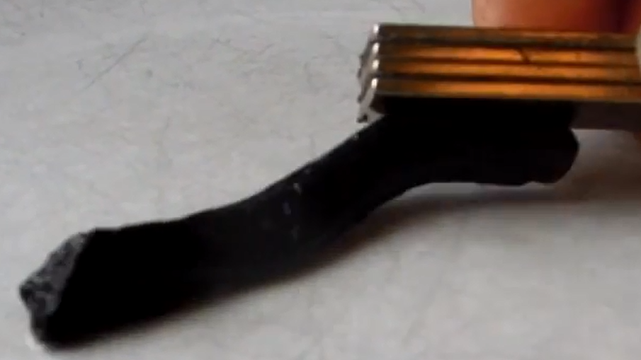
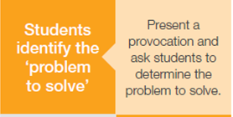
Transfer to a different context
https://www.youtube.com/watch?v=dDD67ydGEac
Science ASSIST
http://assist.asta.edu.au/
Notes:
SLIDE NOTES
An indication of really understanding something, is being able to transfer the principles to a new context.
This you tube video was used as a provocation for engaging Year 4 students in a lesson on contact and non contact forces. Students watch the video, try to explain what they have seen, and formulate their own questions and ideas.
TIP: Arrange the viewing so students cannot see the video title.
The CLE (Connected learning Experience (which is a lesson sequence on this resource) can be found on the Australian Science ASSIST website and on Scootle.
Play the video for the participants.
Ask them what it makes them think or wonder. If it did contain something magnetic, what might that something be? What wouldn’t it be? Participants may notice how this technique arouses curiosity and gives purpose to the topic of study.
VIDEO
‘Home made magnetic slime’ YouTube (0:41 min)
https://youtu.be/dDD67ydGEac
Australian Science ASSIST website
http://assist.asta.edu.au/
‘Magnetism and electrostatics’
https://assist.asta.edu.au/resource/3436/magnetism-and-electrostatics-year-4-cle?search-id=8f0fb16
https://assist.asta.edu.au/html/MagnetismandElectrostatics.html

Slide 36
http://neilatkin.com/category/science/
Notes:
SLIDE NOTES
Other ideas can be found on the Neil Atkin Three Act Science website.
Neil Atkin is a teacher in England who looked at the principles of Three Act maths, and decided to apply the principles to improve the motivation of students in his science classes.
He felt his students lacked initiative and perseverance, didn’t retain material, avoided word problems and just wanted to be given the formula. Maybe you have experienced this in your students at times.
In his words, he felt his Science classes “needed a makeover too”.
RESOURCES
Neil Atkin Three Act Science – Alternative approaches to Science Teaching
http://neilatkin.com/category/science/

Slide 37
A
What are you wondering?
Becoming ‘problem finders’
http://neilatkin.com/2015/05/03/three-act-science-alternative-approaches-to-science-teaching/
Notes:
SLIDE NOTES
Here is an example of a provocation that Neil Atkin uses on his website. This video has 3 identical cartons – one is full, one half full, one empty. The cartons are slowly and simultaneously being pushed over by a rod.
By showing the video, he is inviting his students to become ‘problem finders’.
Invite participants to imagine watching this happen, but that the video stops before any carton begins to fall.
Show the video.
What questions come to mind?
ACTIVITY
Ask participants:
If you think the last carton to fall over is the full one on your left, raise your left hand.
If you think its the half full in the middle raise both hands.
If you predict it to be the empty one on your right raise your right hand.
Keep your hand/s up, go and find someone who disagrees with you and tell them why they are wrong.
How many of you are curious to know whether you are right?

Slide 38
Notes:
SLIDE NOTES
Having had students identify the problem and predict the answer, what do you think the next teacher actions could be?
DISCUSSION
Ask participants to formulate a possible process using techniques from the procedure to problem solving strategy. (1 minute)
Collect some of the ideas. For example, the teacher would:
wait for student questions before giving information
not give students the steps to take in order to investigate the answer.
Emphasise that once the answer is revealed, people stop being curious about it. Students will be more interested in planning and conducting an investigation if they do not know what will happen.

Slide 39
Notes:
SLIDE NOTES
Consider what the students have been required to do:
Identify the necessary information
What information would you want if you were the student?
Give participants a minute to generate some questions.
In the past students have asked questions such as:
“What do the cartons contain?”
“How big are the cartons?”
“How heavy is the full carton?”
2. Identify the steps to solve the problem.
Students would plan an investigation to find out the answer.

Slide 40
Notes:
SLIDE NOTES
It is important to give opportunity for reflection.
Did the process work?
Was it the best way to approach the problem? Why?
Do you think the result would always be the same, or would it depend, for example, on the contents of the carton?
As in the maths example, this could also be an opportunity to ‘go back around the loop’, and to try again.
ACTIVITY
Ask participants to look at the ‘Reflecting on thinking and processes’ element of the Critical and creative thinking continuum. What could ‘reflection’ look like in students at the level they are teaching?

Slide 41
Notes:
HANDOUT :
Handout 6: Burglar and real estate agent
Print one copy of Handout 6, ‘The burglar and the real estate agent’ for each participant.
SLIDE NOTES
The final technique of this strategy is to include irrelevant information. The techniques in ‘From procedure to problem solving’ can be used in sequence, or independently of other techniques.
ACTIVITY
Separate the participants into 2 groups.
Group 1: Pretend they are a burglar.
Group 2: Pretend you are a real estate agent.
Participants read the story and underline the five points that would be most important to their allocated perspective.
SLIDE NOTES Ask participants of the different groups to share the points they have prioritised. Emphasise that relevance or irrelevance can change depending on the purpose.
Students also need to be clear about the purpose in order to decide what is relevant or not relevant.

Slide 42
Notes:
SLIDE NOTES
English often includes irrelevant information. We give students a large piece of text, ask them to locate a key piece of information within it, and to disregard the rest. This is what we just did with the ‘Burglar and the real estate agent’ text. However, we don’t usually include irrelevant information in subjects like maths and science. In some learning areas, we tend to give all the information required, and only the information required. In the real world, and in particular in an information rich society, students need to be able to identify pertinent information, and be clear about why they need it and how it would be used.
DISCUSSION
Ask participants to discuss what the learning intention of the technique ‘Include irrelevant information’ might be.
When might you use this technique of including irrelevant information?
When would you not use it? What might you need to consider?
Ask participants to feedback their ideas.
INFORMATION FOR FACILITATORS
Irrelevant information may be distracting or confusing to some students, but in the real world, and in particular in our information rich, stimulating environments, being able to filter out the irrelevant and distracting is crucial to success. Participants should consider how they might safely support their students to develop skills in dealing with irrelevant information.

Slide 43
Notes:
HANDOUTS
Handout 7: Sorting Cards: Secondary ‘Procedure to problem solving’ Task and/or Primary ‘Procedure to problem solving’ Task.
Print Handout 7, one-sided. This handout is the collated ‘before and afters’ for Procedure to problem solving strategy.
Cut up and place into separate envelopes. Each envelope should have the ‘before’ and ‘after’ examples from just one Learning Area.
SLIDE NOTES
This is an activity to build our expertise in transferring this strategy to other contexts.
ACTIVITY
Work in a small group of 2 or 3 to match the pairs from one envelope.
Decide which one you think would be the ‘before transformation’ task and which would be the ‘after transformation’. Which technique was used?
Participants could compare ideas with another group.

Slide 44
Notes:
HANDOUTS
Handout 8: A3 ‘Before and after’ for each learning area.
Each participant should have the example that they were considering in the previous activity.
DISCUSSION
Ask participants to collect the corresponding A3 ‘Before and after’ handout to compare. Do they agree with the writers? How might they have transformed the task differently?
INFORMATION FOR FACILITATORS
Participants may be interested in looking at the other learning areas. If there are insufficient copies, explain where the handouts can be found on the Leading Learning website.
http://www.acleadersresource.sa.edu.au/index.php?page=into_the_classroom

Slide 45
Notes:
HANDOUTS
Handout 9: ‘Have a go’ sheet.
Distribute blank A3 ‘Have a go’ sheets.
ACTIVITY
Being able to apply the learning is an important part of developing deep understanding. Ask participants to work with a partner, transferring their learning about the techniques of this strategy to one or more other learning areas. They could use the same context for the techniques (as Dan Meyer did), or a different ones (as done in most of the A3 examples), a single learning area, or a range of learning areas.
If they have used any of these techniques before, suggest that they stretch themselves by considering unfamiliar ways of how it might be applied, for example, in a different learning area or with a different kind of activity.
INFORMATION FOR FACILITATORS
Participants may notice that the strategies and techniques of Transforming Tasks can overlap in some contexts.
It may be useful for them to see the strategies and techniques as ‘doorways into the same room’ – that of getting students doing the thinking.

Slide 46
Notes:
Refer to the Critical and Creative Thinking continuum.
DISCUSSION
What kind and level of thinking do you think your ideas will provoke?
KEY MESSAGE
Analysing the critical and creative thinking required in a task helps us to identify how intellectually challenging the task is.

Slide 47
47
Notes:
SLIDE NOTES
This commitment to action requires participants to trial an idea and showcase it to the group as an artefact, that will take no more than 3 minutes to share.

Slide 48
Notes:
SLIDE NOTES
This slide reflects on the key messages of this workshop.
The ? Is for something that was a key personal message.
DISCUSSION
Ask participants to reflect on and discuss the key messages with their table.
Each table to share their understandings of one of the key messages – ensure that all key messages are covered.
INFORMATION FOR FACILITATORS
The key messages:
ALL students need to engage in both fluency and fluency plus tasks.
One type of thinking is not being prioritised over another. We need both fluency AND fluency plus thinking.
Analysing the level of thinking a verb requires in a task, helps us to identify how intellectually challenging the task is.
The Teaching for Effective Learning (TfEL) Framework, General Capabilities Continuum and the Transforming Tasks strategies work in synergy towards the pedagogic shift required for 21st Century education.
Students with growth mindsets are more likely to persist with challenging tasks and see failure as an important part of learning.
Metacognitive strategies are low cost and high impact for improved learning outcomes.

